Slide 1
SITUATIONAL REPORT
ST. JOSEPH HOSPITAL, JIRAPA
JUNE 2023

Slide 2
UPDATE ON HOSPITAL STATE
PERIOD UNDER REVIEW:
APRIL 2023 – JUNE 2023

Slide 3
Major Concerns: AT BEGINNING OF YEAR 2023
Decrease hospital mortality rate and improve clinical and public health indicators
Move the hospital from folder to paperless system – LHIMS
Provision of modern medical equipment (IGF, Philanthropists, Project cure)
Improvement on procurement processes and logistic supply chain (GHANEPS)
Inception of operational theatre recovery room
Refurbishment of mental ward and training of addiction/rehab staff
Provision of laboratory annex
Outsourcing of hospital canteen
Maintenance of hospital fleet – transportation
Renovation of mothers’ hostel
Expansion of staff medical subsidy policy (Spouses)
Provision of new borehole
Provision of Obstetrics/Gynaecology theatre at maternity ward
Staff in-service training
Creation of hospital website (www.jirapasjh.com)
Solar energy backup system (50,000 – 80,000 cedis per ward)

Slide 4
Major Activities Carried Out - 1
Weekly clinical meetings, NND audits and monthly mortality conferences
Health education ongoing twice weekly on Radio Gangaa
In-service training (Referral team, theatre team, Orientation of new staff etc)
First quarter staff durbar
Acquisition of new medical equipment
Addiction rehabilitation training of staff
Customised glucometer distribution
Vodafone monthly credit subscription
Covering of old mattresses (SW/RW) - 19
Joint management retreat (Jirapa/Nandom hospital)
Second quarter blood donation exercise

Slide 5
Major Activities Carried Out - 2
Provision of new borehole
LHIMS (Lightwave health information management system) - training and implementation
GHANEPS (Ghana electronic procurement system) – training and implementation
Client satisfaction survey 2023
B.O.T staff accommodation needs survey (questionnaire)
Provision of laboratory annex
Nsawam Physiotherapists visit
Annual audit – Diligence Consult
Inception of Saving lives and livelihood project (SLL)
X-ray door (radioprotected)
New Ultrasound machine
Orientation of new staff

Slide 6
HUMAN RESOURCE
CATEGORY | CHAG | GHS | CASUALS | TOTAL
Medical Officers | 2 | 3 | 0 | 5
Physician Assistants | 4 | 0 | 9 | 13
Community Nurses | 17 | 0 | 0 | 17
Registered General Nurses | 54 | 28 | 11 | 93
Midwives | 26 | 32 | 4 | 62
Enrolled Nurses | 63 | 22 | 0 | 85
Allied Health | 20 | 17 | 4 | 41
Admin & Support staff | 41 | 1 | 0 | 42
Pharmacy – Pharmacist Technicians, MCAs | 1 | 1 | 5 | 7
Other Staff | 0 | 0 | 59 | 59
Total | 228 | 104 | 92 | 424
STUDY LEAVE – 62 (CHAG-38, GHS-24); NSP – 65

Slide 7
CLIENT SATISFACTION SURVEY (JUNE 2023)
QUESTION | YES DEFINITELY | YES MOSTLY | NEUTRAL | NO, NOT REALLY | NO, NOT AT ALL
SAFETY AND SECURITY DURING STAY | 50% | 30% | 7% | 7% | 6%
STAFF KNOWLEDGE AND COMPETENCE | 68% | 25% | 4% | 1% | 2%
WAS PAIN ADEQUATELY MANAGED | 49% | 35% | 9% | 4% | 3%
EMOTIONAL SUPPORT PROVIDED | 28% | 33% | 17% | 8% | 14%
PRIVACY RESPECTED | 59% | 32% | 4% | 4% | 1%
CLEAR INSTRUCTIONS GIVEN ON HOW TO MANAGE CONDITION | 51% | 30% | 3% | 8% | 8%
POTENTIAL RISKS/BENEFITS OF TREATMENT EXPLAINED | 46% | 36% | 7% | 5% | 6%
CULTURE/RELIGION RESPECTED | 54% | 32% | 11% | 3% | 0%
FINANCIAL SUPPORT + NHIS | 42% | 41% | 10% | 7% | 0%
INFO POLICIES/PROCEDURES | 11% | 15% | 5% | 8% | 61%
INFO ON TREATMENT COMPLICATIONS | 41% | 40% | 8% | 4% | 7%
OPPORTUNITY TO GIVE FEEDBACK | 14% | 15% | 9% | 7% | 55%

Slide 8
QUESTION | YES SATISFIED | SATISFIED | NEUTRAL | DISSATI- SFIED | VERY DISSATISIED
WAITING TIME FOR APPOINTMENTS | 7% | 13% | 6% | 23% | 52%
AVAILABILITY OF PARKING FACILITIES | 9% | 21% | 62% | 5% | 3%
RANGE OF SERVICES OFFERED | 25% | 59% | 9% | 7% | 0%
QUALITY AND VARIETY OF MEALS | 11% | 15% | 5% | 8% | 61%
INTERDEPARTMENT COMMUNICATION | 7% | 13% | 77% | 1% | 2%
FACILITY CLEANLINESS AND HYGIENE | 32% | 58% | 3% | 6% | 1%
STAFF RESPONSE TO NEEDS/CONCERNS | 56% | 31% | 6% | 6% | 1%
INVOLVEMENT IN DECISION-MAKING | 30% | 37% | 10% | 11% | 12%
EFFECTIVENESS OF COMMUNICATION | 31% | 46% | 14% | 9% | 0%
ACCESSIBILITY AND CONVENIENCE OF SERVICES | 6% | 53% | 30% | 8% | 3%
COORDINATION OF CARE WITH STAFF | 7% | 53% | 36% | 0% | 4%
ADDRESSING OF LANGUAGE BARRIER | 70% | 20% | 6% | 4% | 0%
FACILITIES FOR INDIVIDUALS WITH DISABILITY | 2% | 19% | 56% | 19% | 4%
*LIKELIHOOD OF RECOMMENDING | 25% | 64% | 6% | 3% | 2%

Slide 9
ANY OTHER THINGS TO SHARE (CLIENT)
FRIENDLY STAFF
SATISFIED WITH SERVICES
LONG WAITING TIME – ESPECIALLY AT RECORDS, LABORATORY, OPD AND X-RAY DEPARTMENTS WITH NO COMMUNICATION AND ENCOURAGEMENT FROM STAFF
POOR ATTITUDE OF SOME STAFF – ESPECIALLY AT RECORDS, NURSING, MATERNITY, BILLING UNIT
DIFFERENT DIET FOR SOME PATIENT EG. ULCER PATIENTS
BILLING TOP-UPS FOR MEDICATION AND SERVICES ARE HIGH
HIGH COST OF GLUCOSE STRIPS ON WARDS
LABORATORY STAFF EXTORT MONIES FROM CLIENT
GOOD ATTITUDE FROM NURSES AND DOCTORS
RELIGIOUS WARD HAS GOOD SERVICES BUT HIGH USER FEES
OVERTAKING AND JUMPING QUEUS ENCOURAGED AT OPD
ELECTRONIC HEALTH RECORDS SYSTEM CAUSING DELAYS
INTRODUCE SPECIAL TREATMENT FOR ELDERLY AT OPD

Slide 10
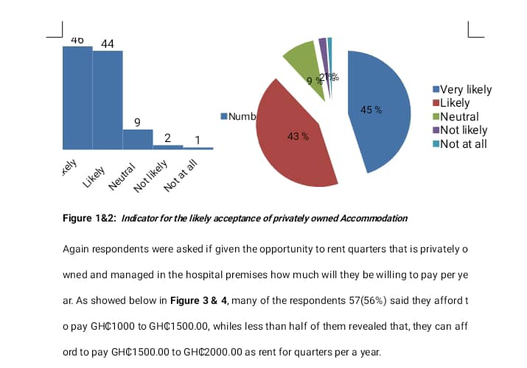
B.O.T - STAFF ACCOMMODATION SURVEY

Slide 11
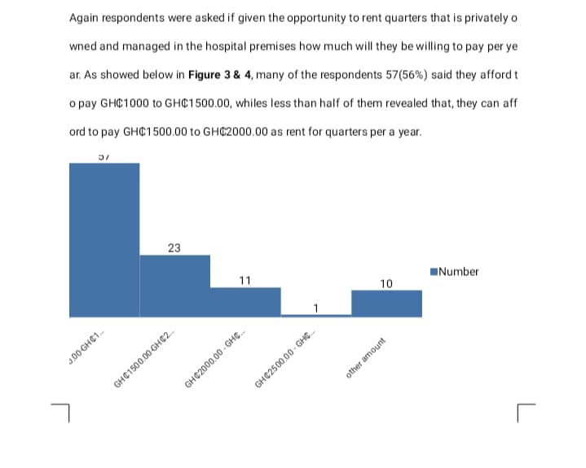

Slide 12
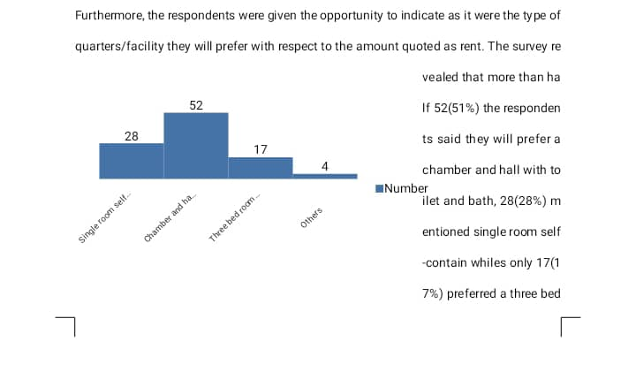

Slide 13
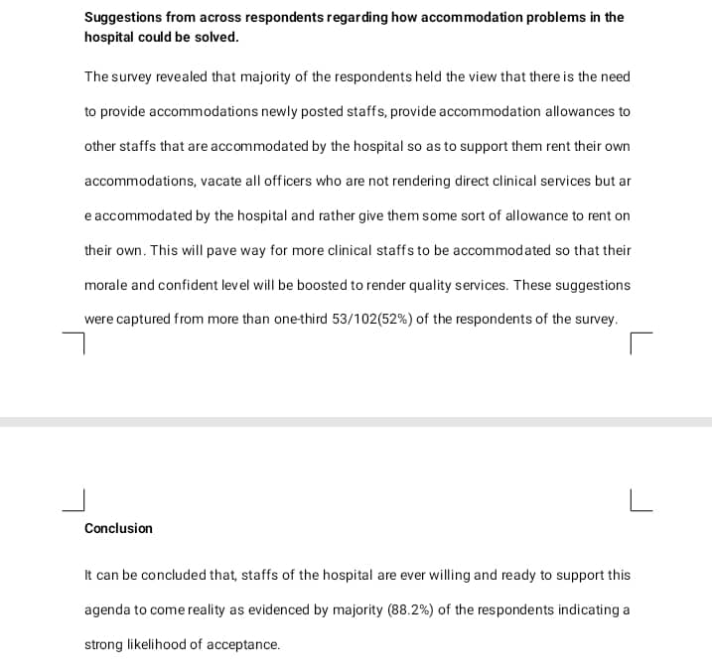

Slide 14
CHALLENGES - 1
Financial challenges
  Delay in NHIS reimbursement
  Low IGF generation
  Increasing cost of supplies and unfavourable payment terms
Infrastructural challenges
  Uncompleted Administration block
  Lack of accommodation for critical staff
  Limited space at NICU, labour ward and mortuary
  Proposed theatre at Maternity (not yet done)
  Uncompleted road and gutter construction

Slide 15
CHALLENGES - 2
Human resource challenges
  Inadequate number of specialists eg. Paediatrician, Obstetrician/Gynaecologist, Neonatologist, Surgeon
  Increased number of casuals and payroll issues
Other challenges
  Inadequate modern medical equipment
  Payment of electricity bills

Slide 16
ACHIEVEMENTS
Twice weekly radio health talks
Inception of MHA addiction training program
Improvement in quantity and care of medical equipment
Improved logistics supply (GHANEPS)
Provision of new borehole
Creation of hospital website (www.jirapasjh.com)
Implementation of LHIMS (paperless system)
Inception of laboratory annex
Client satisfaction survey
Nsawam Physiotherapists visit
2 staff received COVID-19 presidential award
Acquisition of new Ultrasound machine

Slide 17
WAY FORWARD - 1
Renovation of NICU mothers’ hostel (ongoing)
Inception of operational theatre recovery room (ongoing)
Outsourcing of hospital canteen (ongoing)
Peer visit to Nandom St. Theresa Hospital in July 2023
Inception of annual leadership retreat in July 2023
Inception of Hb Electrophoresis test at laboratory
Staff health screening in August 2023
Inception of annual hospital magazine (September 2023)
Family health conference in second half of 2023
Input of casual staff into controller payroll
Procurement of Coagulation machine for laboratory

Slide 18
WAY FORWARD - 2
Introduction of special clinics days at OPD
Implementation of solar energy as back up system
Conversion of current conference room at maternity into Obstetrics and Gynaecology theatre
Electrical rewiring of hospital infrastructure
Provision of sheds for patient relatives
Extension of CCTV cameras to stores
Acquisition of modern medical equipment
Construction of oxygen plant and medical gas pipeline system
Estate developer contract for staff accommodation (BOT)
Continue lobby with Regional minister, MOH, MCE & MP to complete new administration block, hospital road and gutter construction (ongoing)

Slide 19
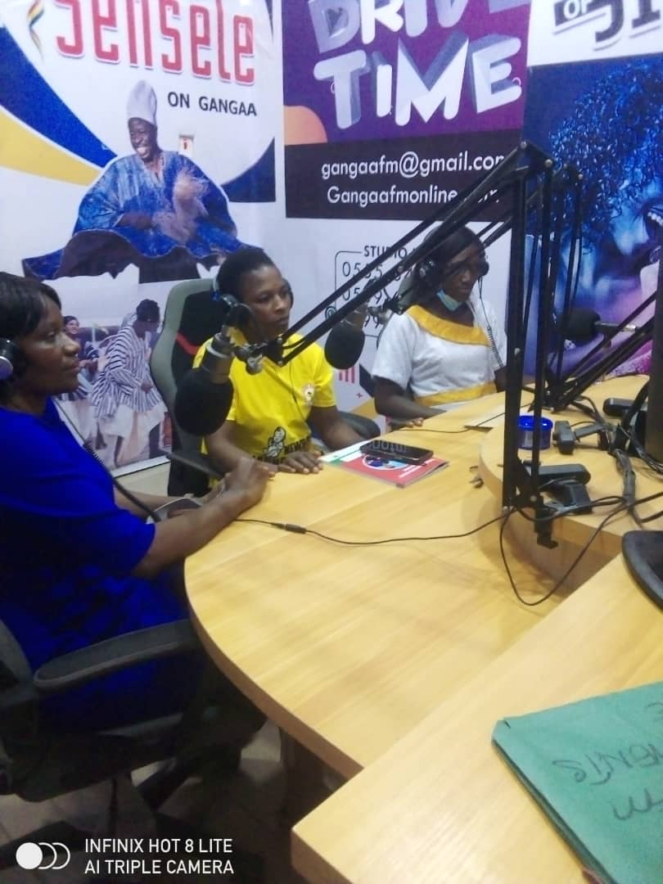
TWICE WEEKLY HEALTH TALKS AT RADIO GANGAA

Slide 20
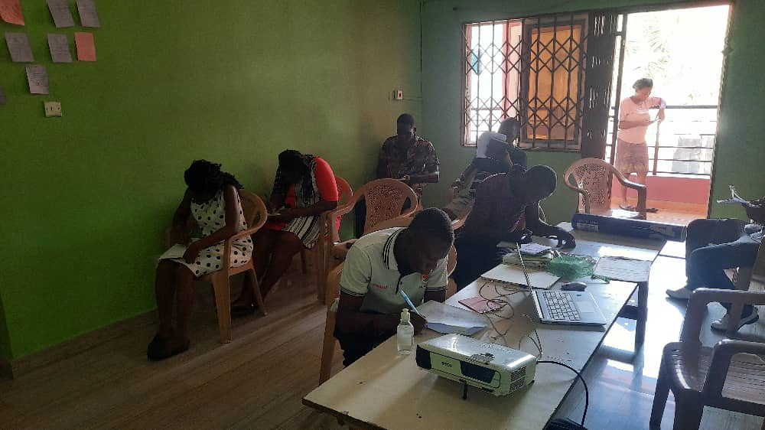
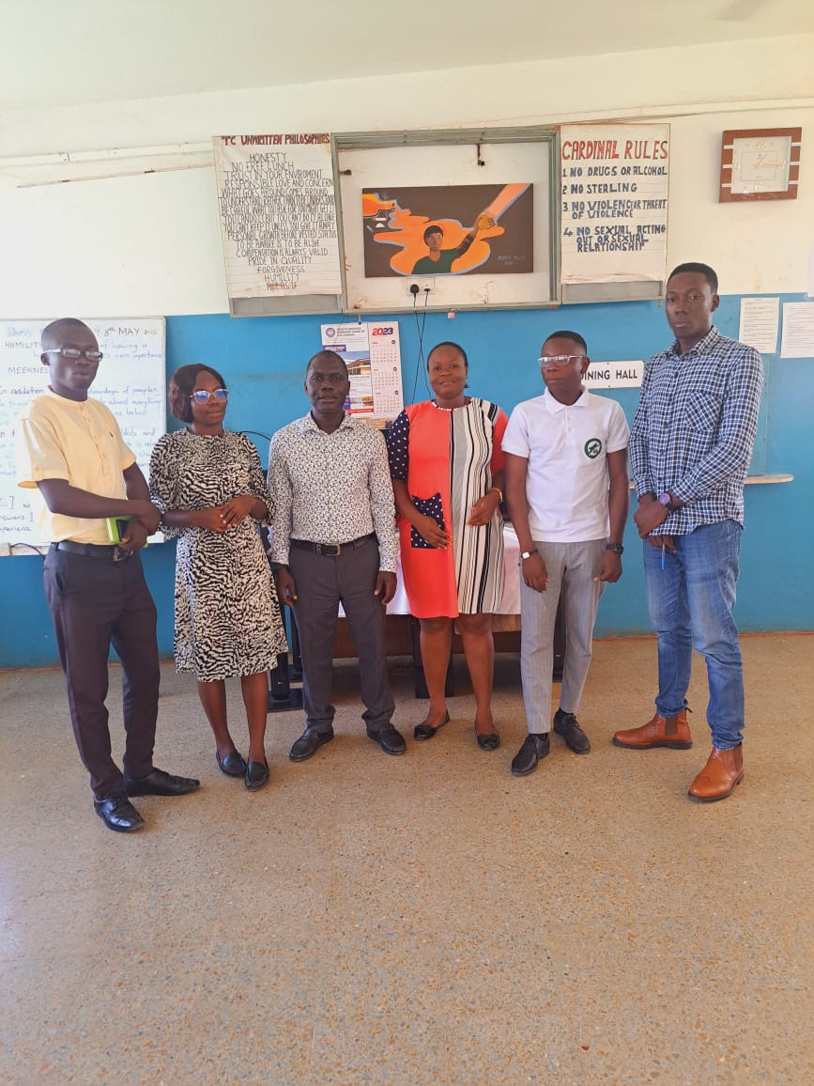
MENTAL HEALTH AUTHORITY – REHAB AND ADDICTION TRAINING PROGRAM

Slide 21
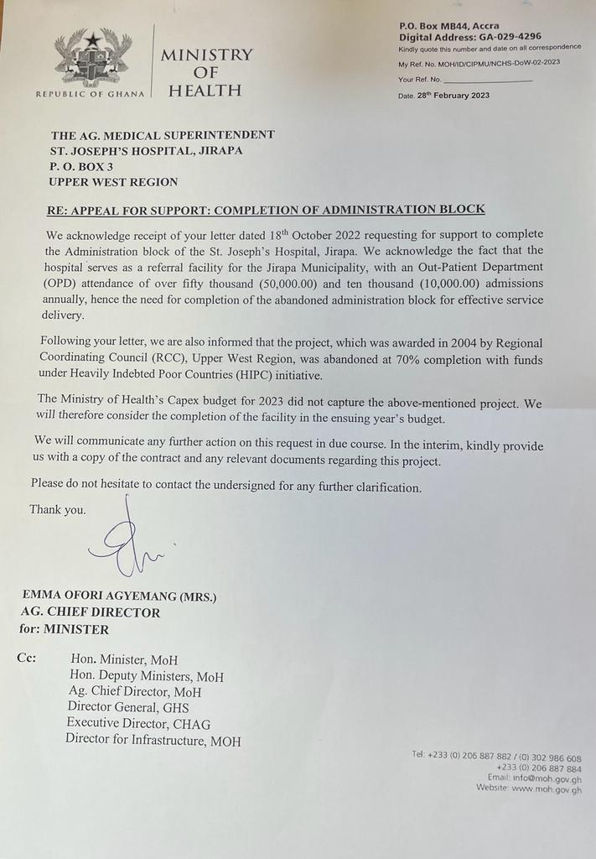
MINISTRY OF HEALTH – COMPLETION OF NEW ADMINISTRATION BLOCK

Slide 22
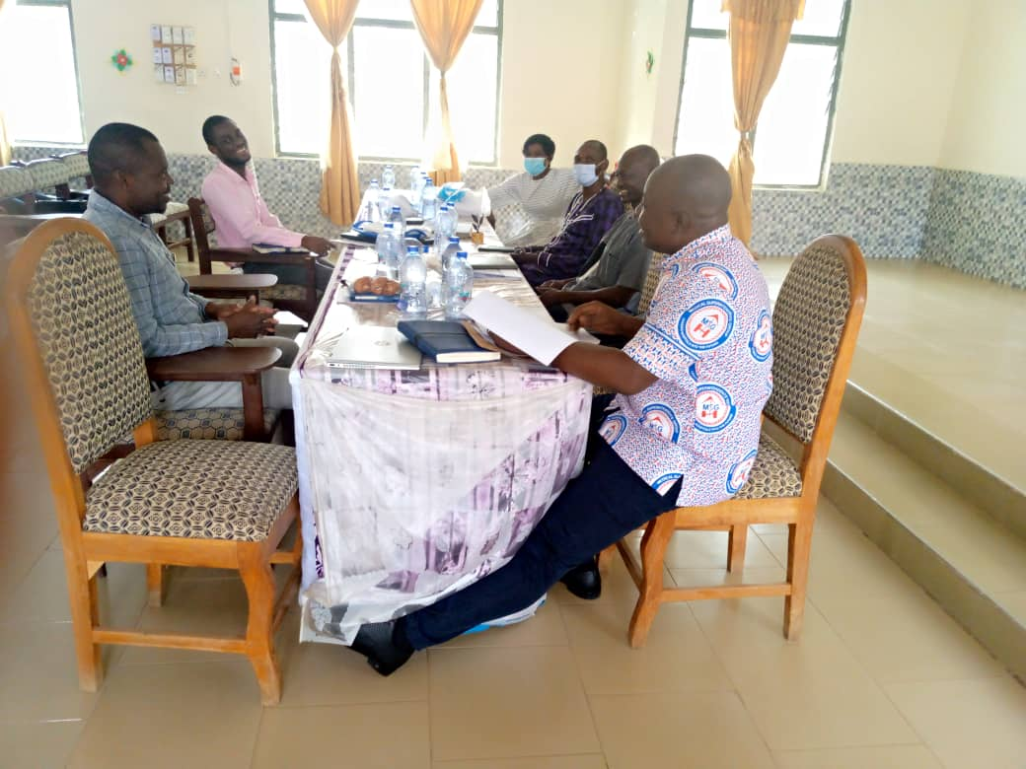
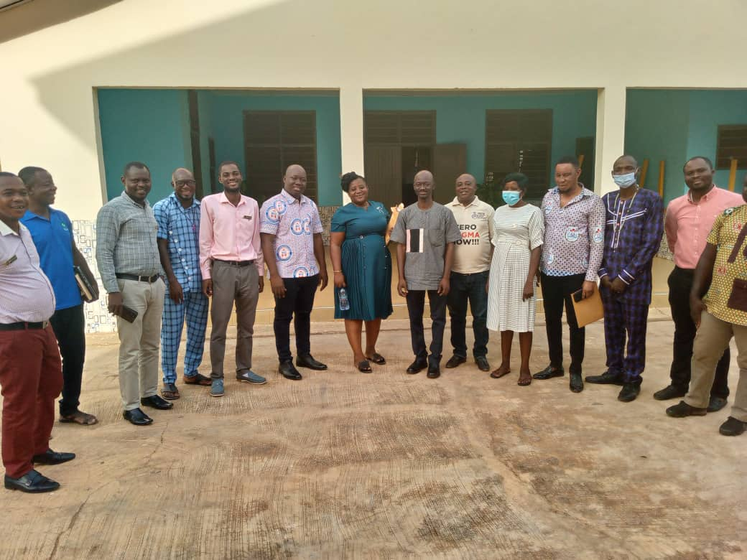
JIRAPA/NANDOM JOINT HOSPITAL MANAGEMENT RETREAT

Slide 23

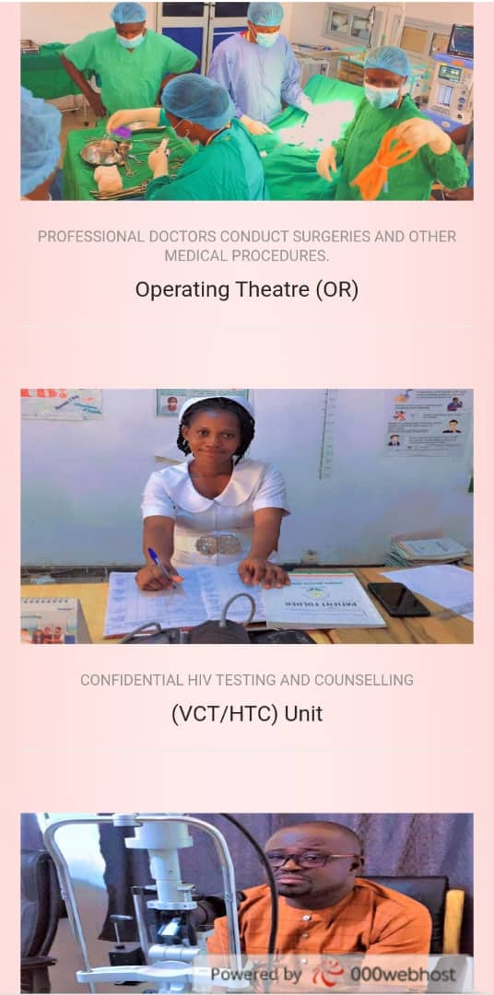
HOSPITAL WEBSITE - www.jirapasjh.com

Slide 24
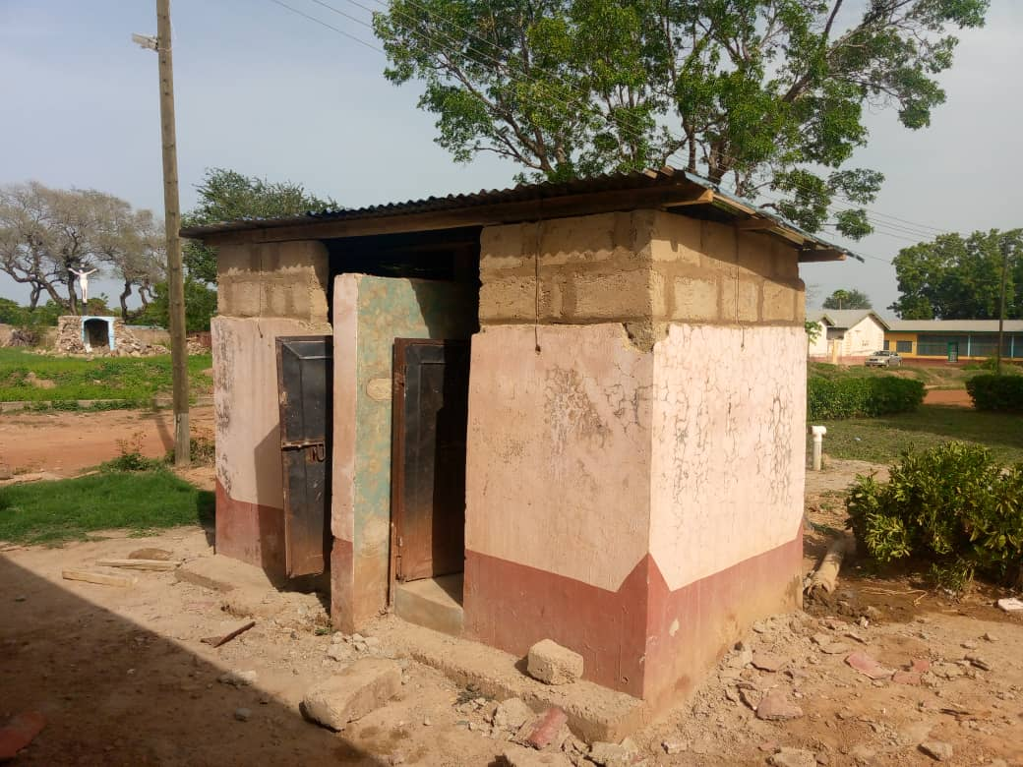
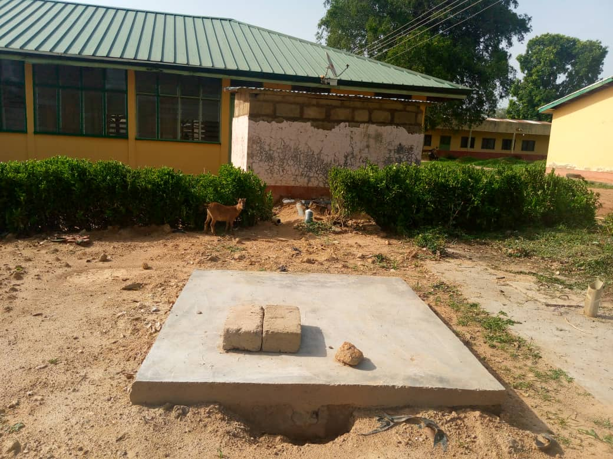
RENOVATED MATERNITY BATHROOMS

Slide 25
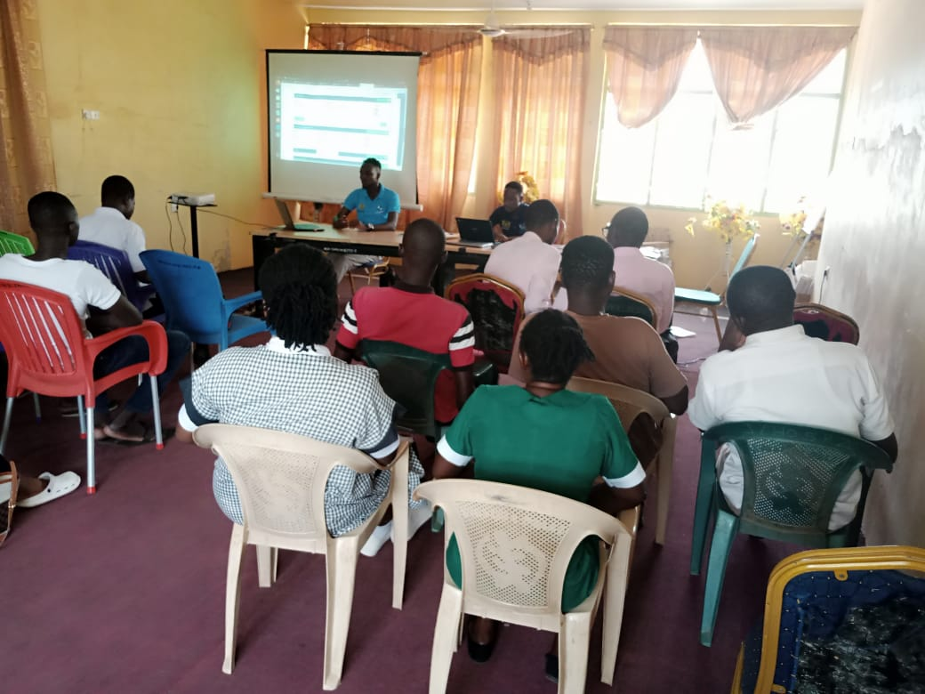
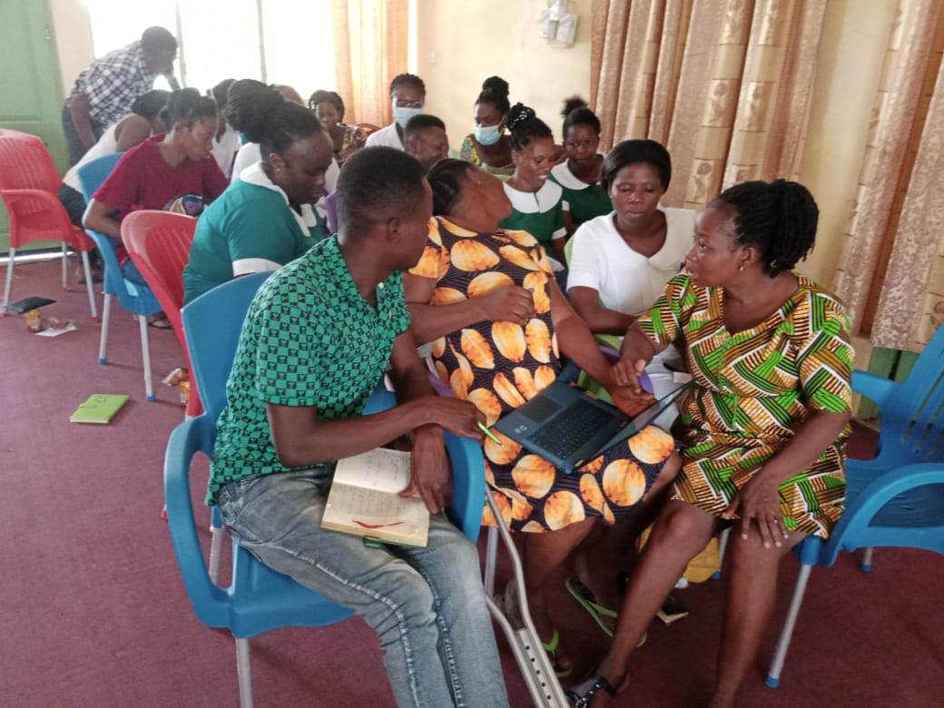
PHASE II OF ELECTRONIC HEALTH RECORDS SYSTEM – LHIMS TRAINING

Slide 26
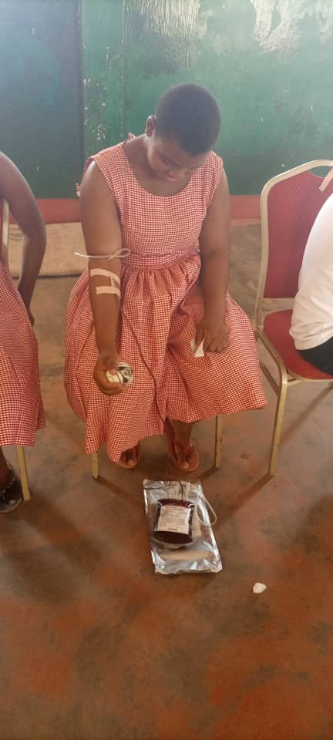
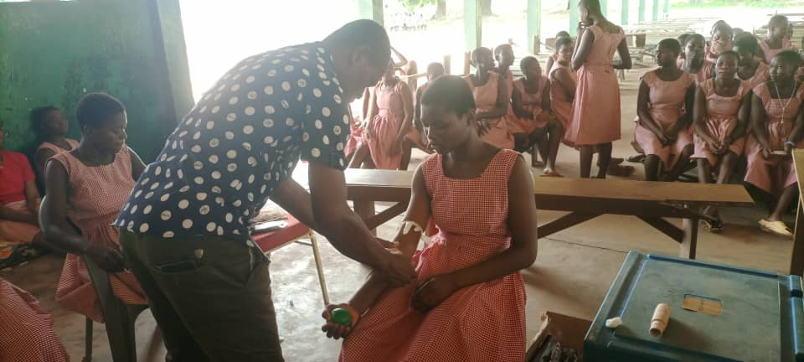
SECOND QUARTER BLOOD DONATION EXERCISE

Slide 27
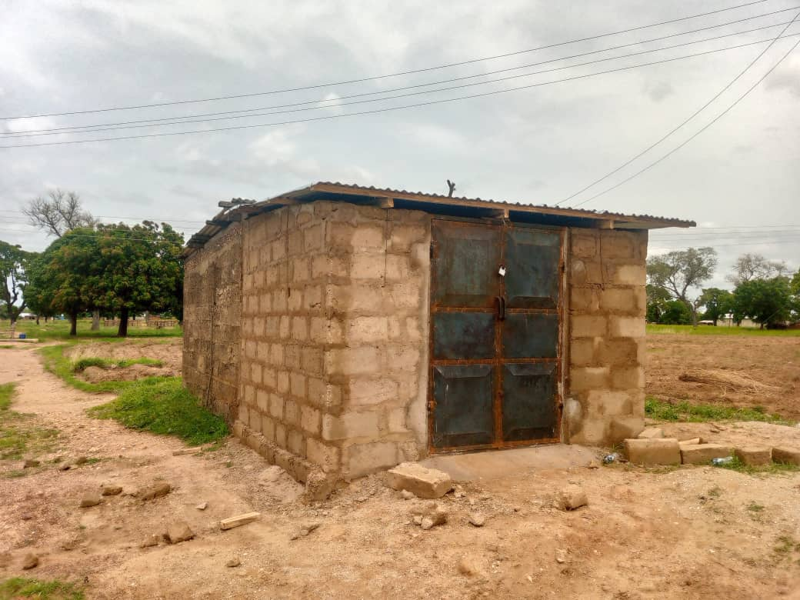
NEW HOSPITAL BOREHOLE – DONATED BY DR. GODFREY BACHEYIE

Slide 28
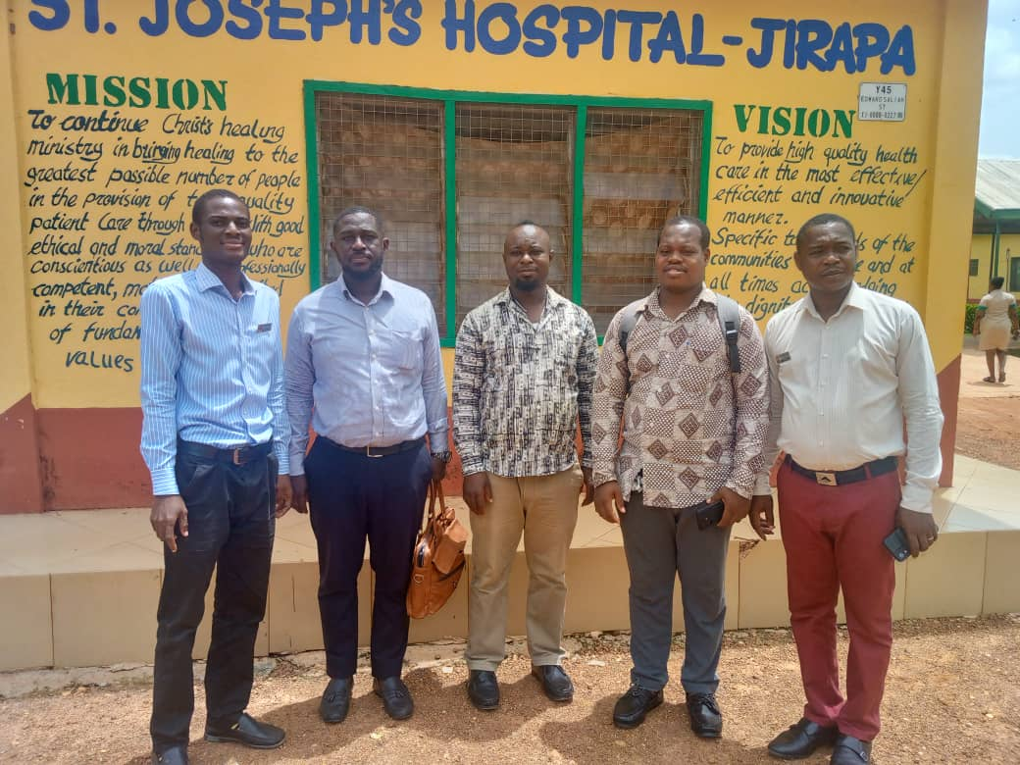
GHANA ELECTRONIC PROCUREMENT SYSTEM IMPLEMENTATION

Slide 29
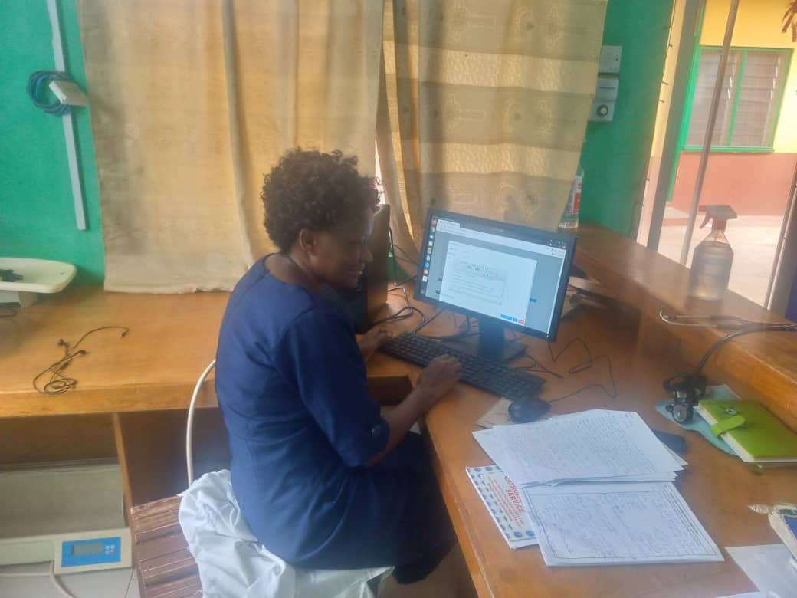
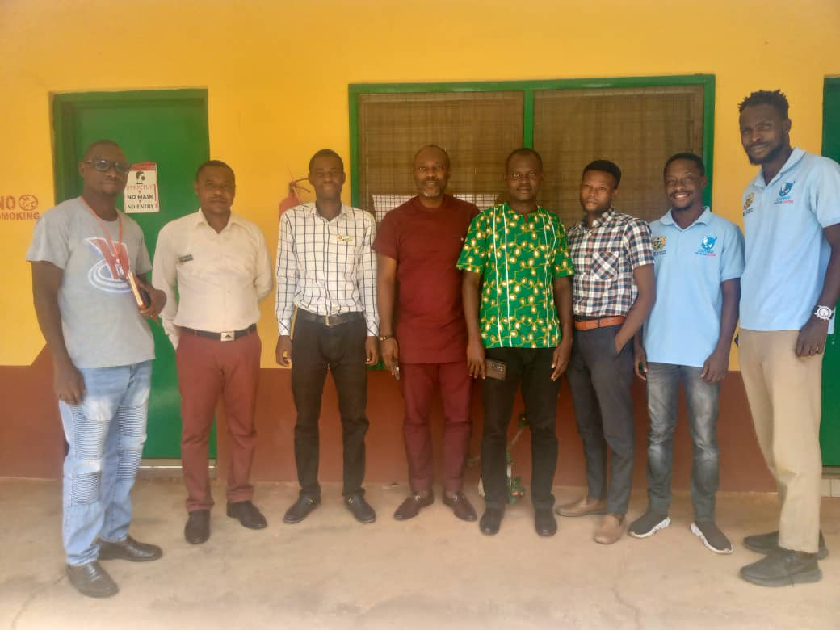
IMPLEMENTATION OF LHIMS PROJECT

Slide 30
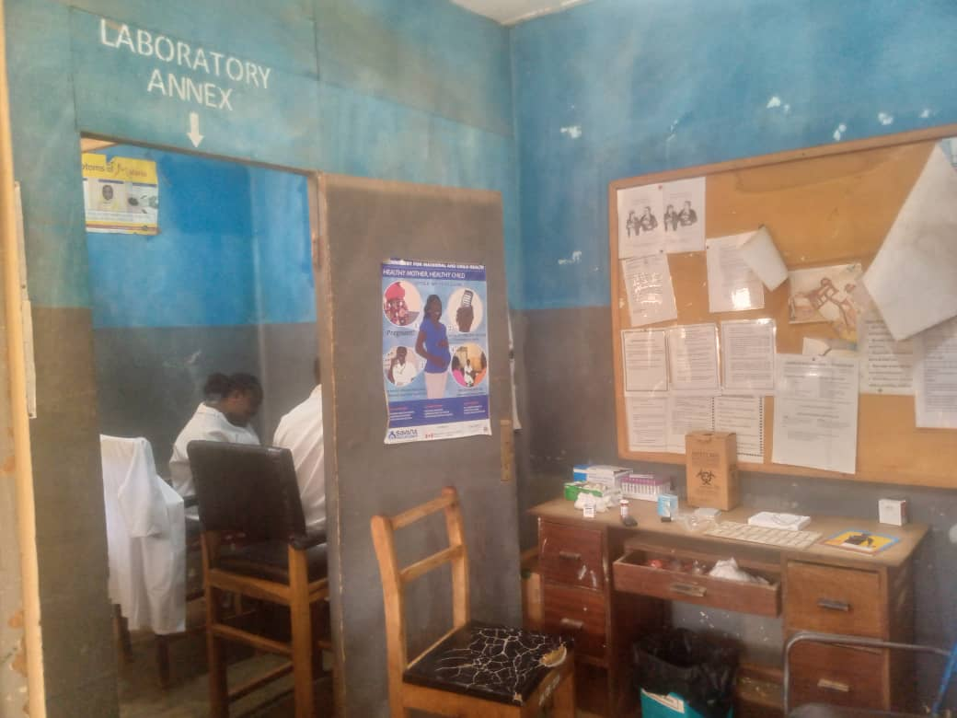
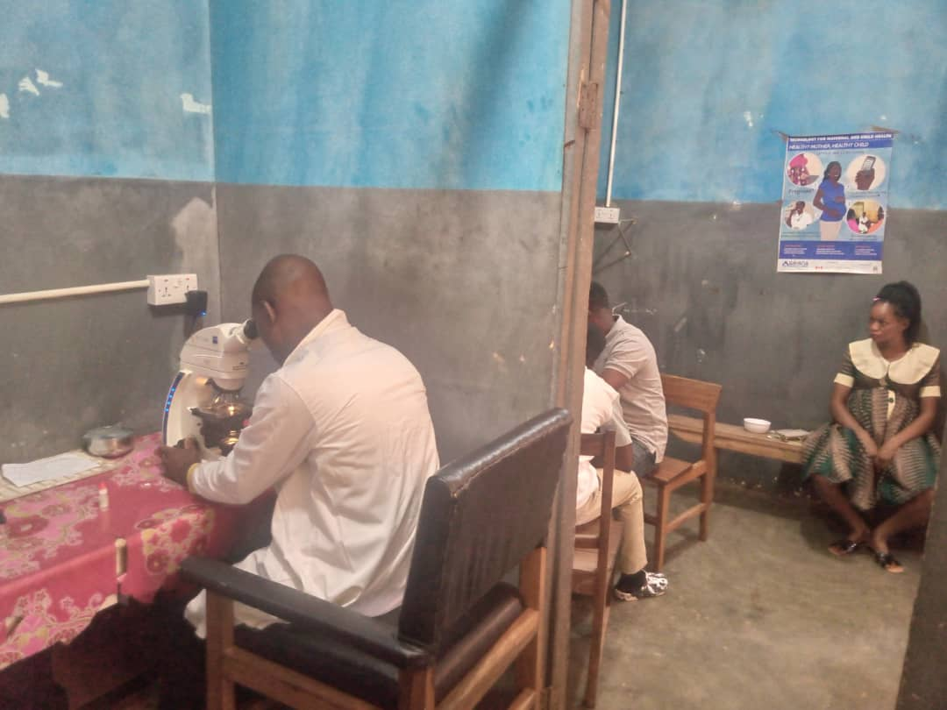
LABORATORY ANNEX

Slide 31
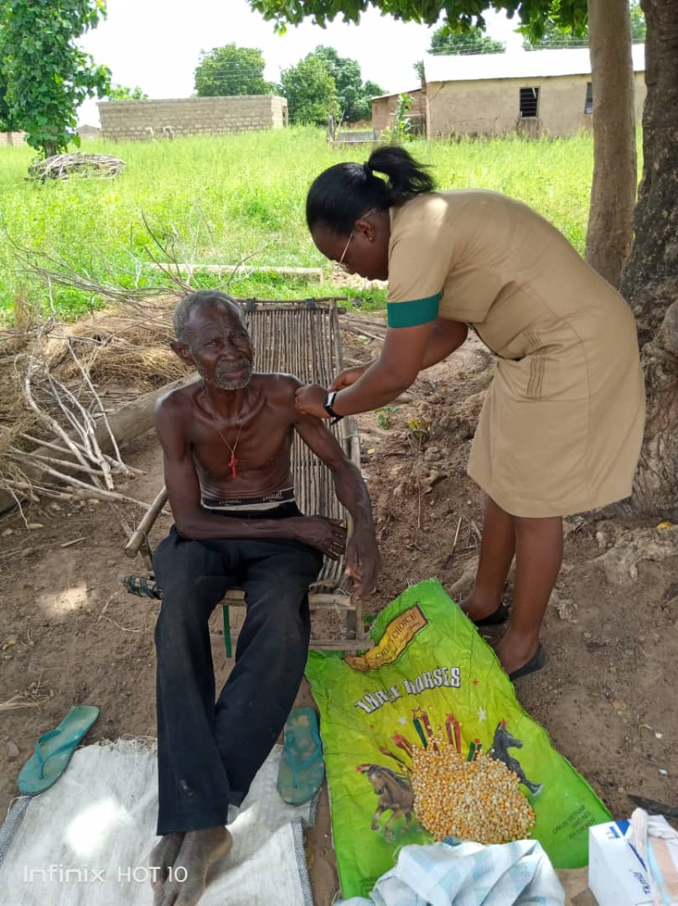
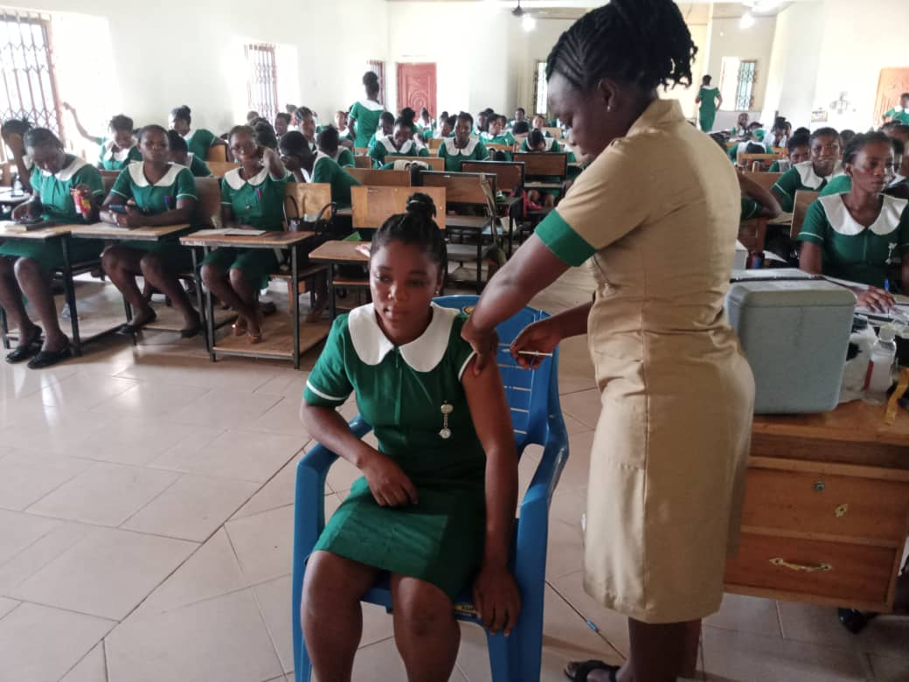
SAVING LIVES AND LIVELIHOOD PROJECT

Slide 32
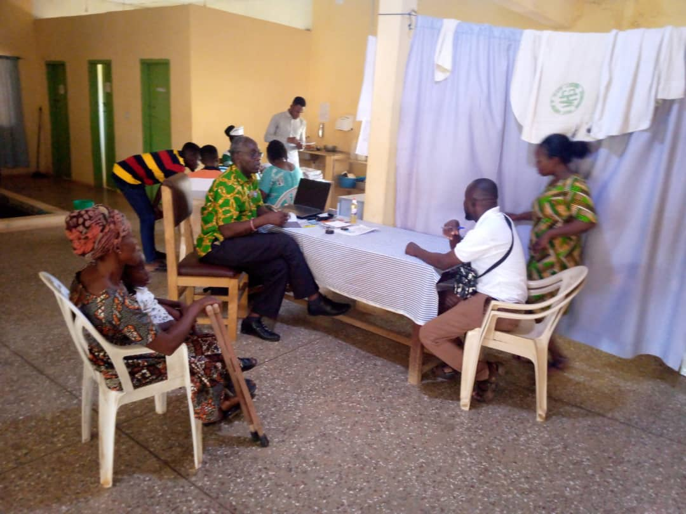
NSAWAM PHYSIOTHERAPISTS VISIT

Slide 33
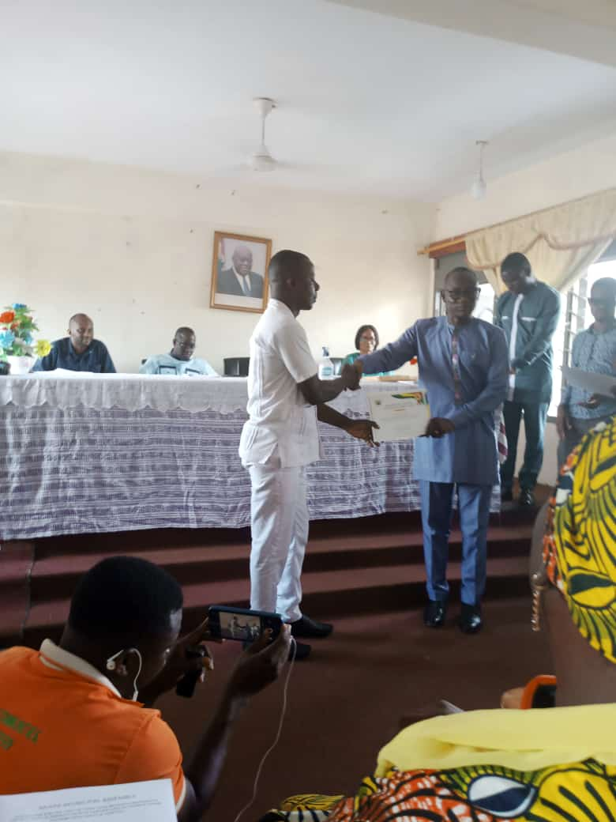
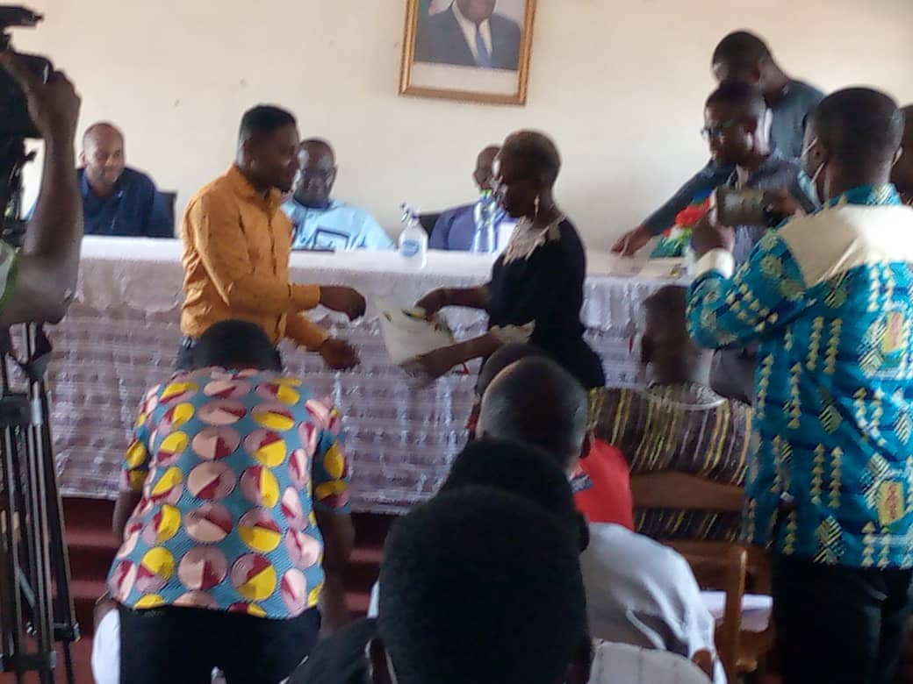
COVID-19 PRESIDENTIAL AWARD
Mr. Nicholas Yeboah, BMS
Mr. Richard Dery, PHN

Slide 34
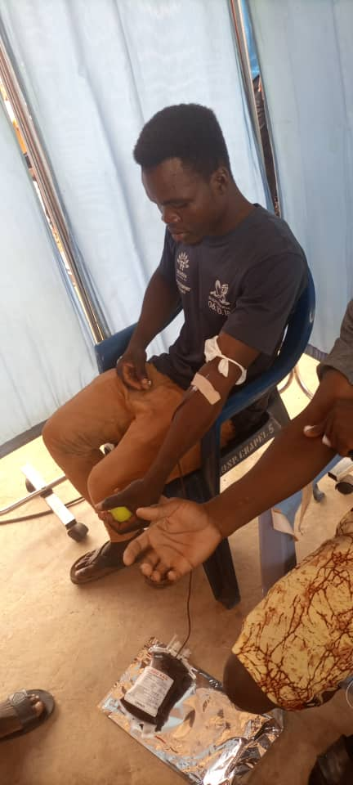
NURSES AND MIDWIVES’ WEEK – BLOOD DONATION

Slide 35
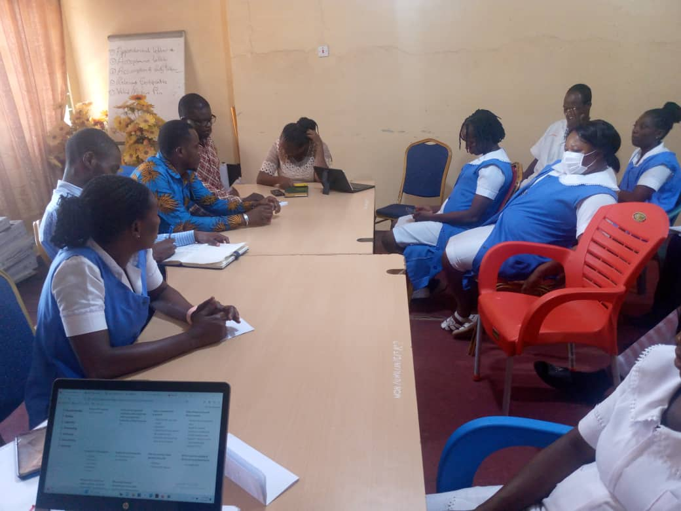
QA/DTC COMMITTEE MEETINGS

Slide 36
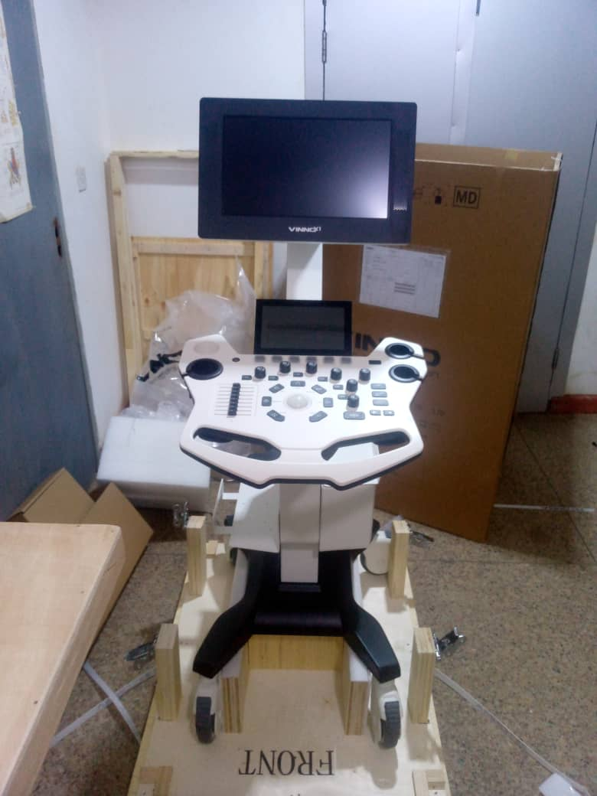
NEW ULTRASOUND MACHINE

Slide 37
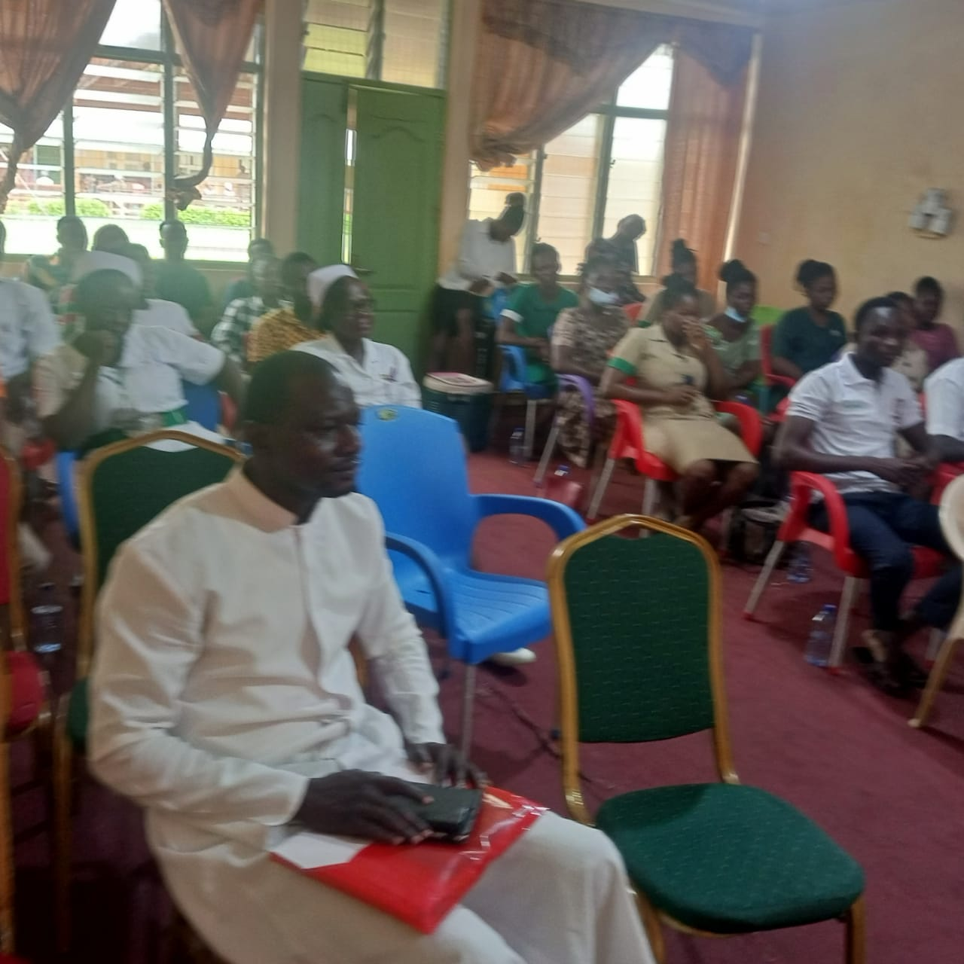
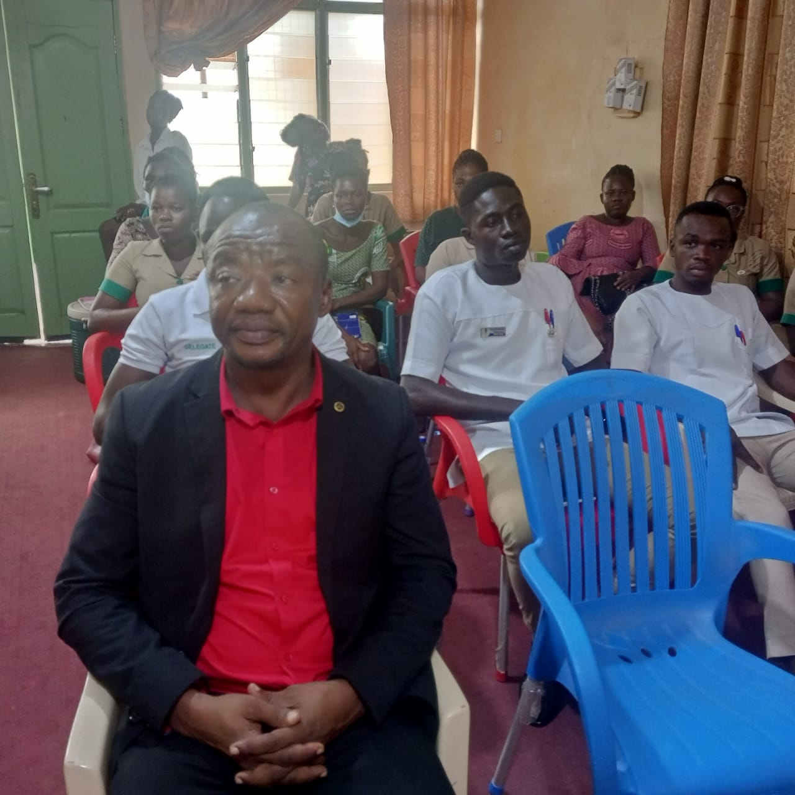
ORIENTATION OF NEW STAFF

Slide 38
BAREKA!!!

